Slide 1
Parallel Computing
Ekkapot Charoenwanit
Software Systems Engineering
TGGS
KMUTNB

Slide 2
Lecture 4:
Multithreaded Programming with Pthreads

Slide 3
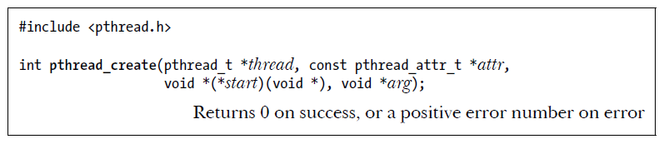

Creating a Thread
Initially, a program consists of a single thread of execution, often referred to as the main thread.
If we want to spawn additional threads from the main thread, we need to explicitly create each new thread using the $pthread_create()$ function:

Slide 4
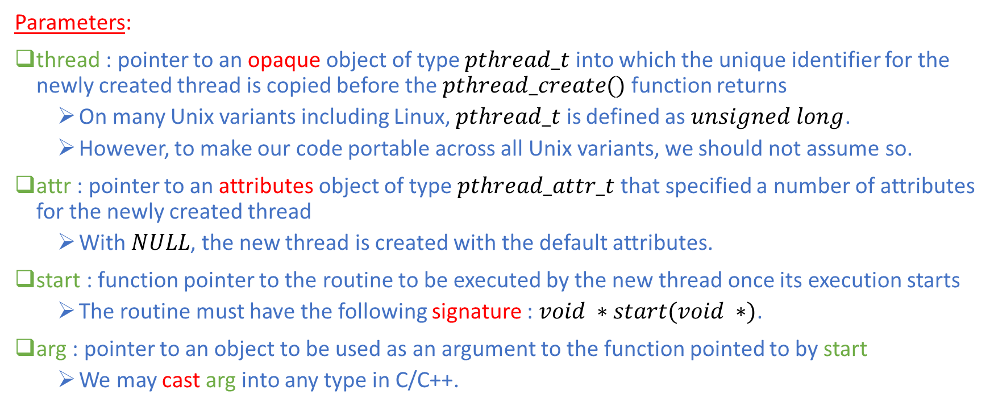
Creating a Thread
Parameters:
thread : pointer to an opaque object of type $pthread_t$ into which the unique identifier for the newly created thread is copied before the $pthread_create()$ function returns
On many Unix variants including Linux, $pthread_t$ is defined as $unsigned long$.
However, to make our code portable across all Unix variants, we should not assume so.
attr : pointer to an attributes object of type $pthread_attr_t$ that specified a number of attributes for the newly created thread
With $NULL$, the new thread is created with the default attributes.
start : function pointer to the routine to be executed by the new thread once its execution starts
The routine must have the following signature : $void ∗start(void ∗)$.
arg : pointer to an object to be used as an argument to the function pointed to by start
We may cast arg into any type in C/C++.

Slide 5
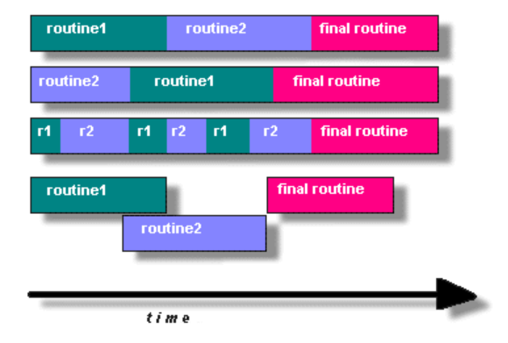

Creating a Thread
After a call to $pthread_create()$, a program has no guarantees about which thread will be scheduled next on the CPU and, on a multiprocessor system, both threads may simultaneously execute on different CPUs.
The OS scheduler decides which thread will be scheduled next.

Slide 6
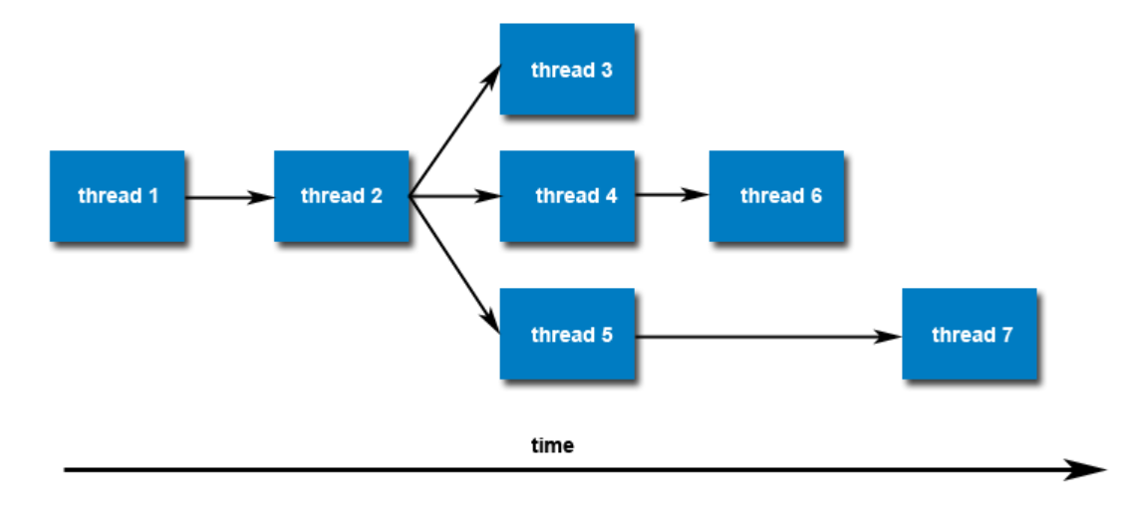
Creating a Thread
Threads do not form a parent-child hierarchy as in the case of processes, which are created via the fork system call.
In other words, once created, threads are peers and can also creates other threads.

Slide 7
Creating a Thread
Live Demo:
Go to Pthreads/ThreadCreate

Slide 8
Creating a Thread
Live Demo:
Go to Pthreads/ArgumentPassing

Slide 9
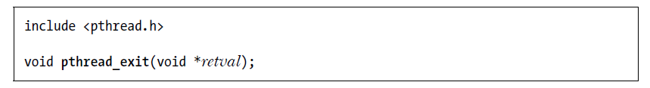
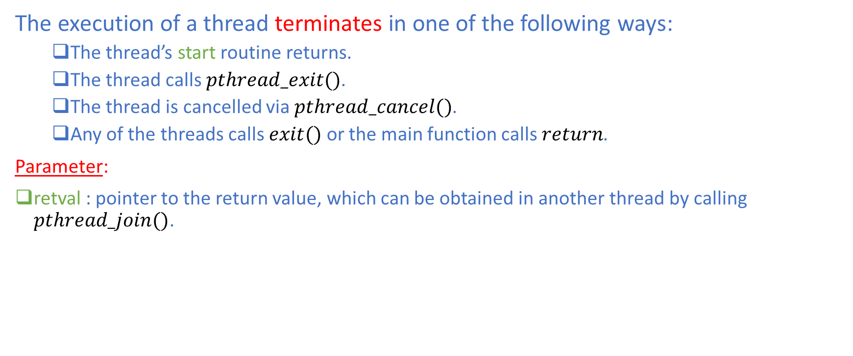
Terminating a Thread
The execution of a thread terminates in one of the following ways:
The thread’s start routine returns.
The thread calls $pthread_exit()$.
The thread is cancelled via $pthread_cancel()$.
Any of the threads calls $exit()$ or the main function calls $return$.
Parameter:
retval : pointer to the return value, which can be obtained in another thread by calling $pthread_join()$.

Slide 10
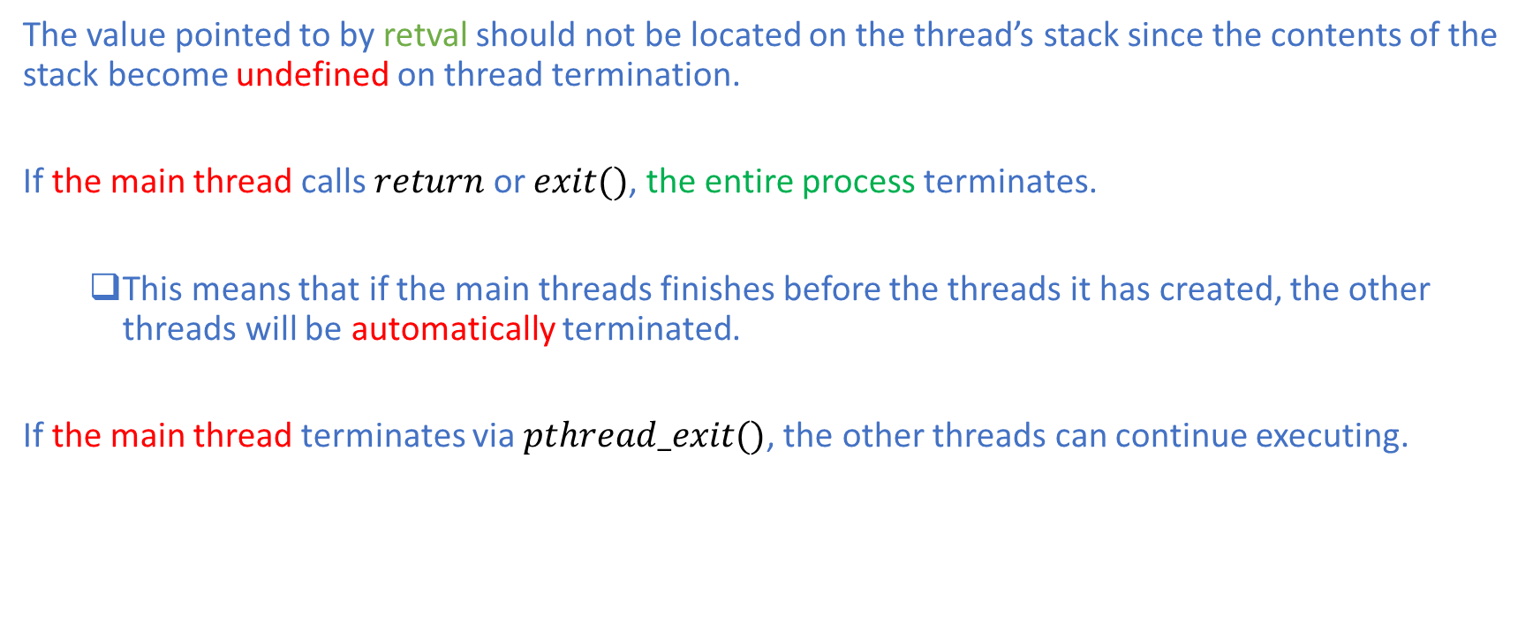
Terminating a Thread
The value pointed to by retval should not be located on the thread’s stack since the contents of the stack become undefined on thread termination.
If the main thread calls $return$ or $exit()$, the entire process terminates.
This means that if the main threads finishes before the threads it has created, the other threads will be automatically terminated.
If the main thread terminates via $pthread_exit()$, the other threads can continue executing.

Slide 11
Terminating a Thread
Live Demo:
Go to Pthreads/ThreadExit

Slide 12
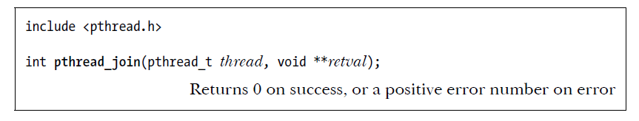

Joining a Thread
The $pthread_join()$ function waits for the thread with the specified thread identifier to terminate:
If the thread has already terminated, $pthread_join()$ returns immediately.
Parameters:
thread : thread identifier object of the thread to be joined
retval : double pointer for retrieving the return value of the specified thread

Slide 13
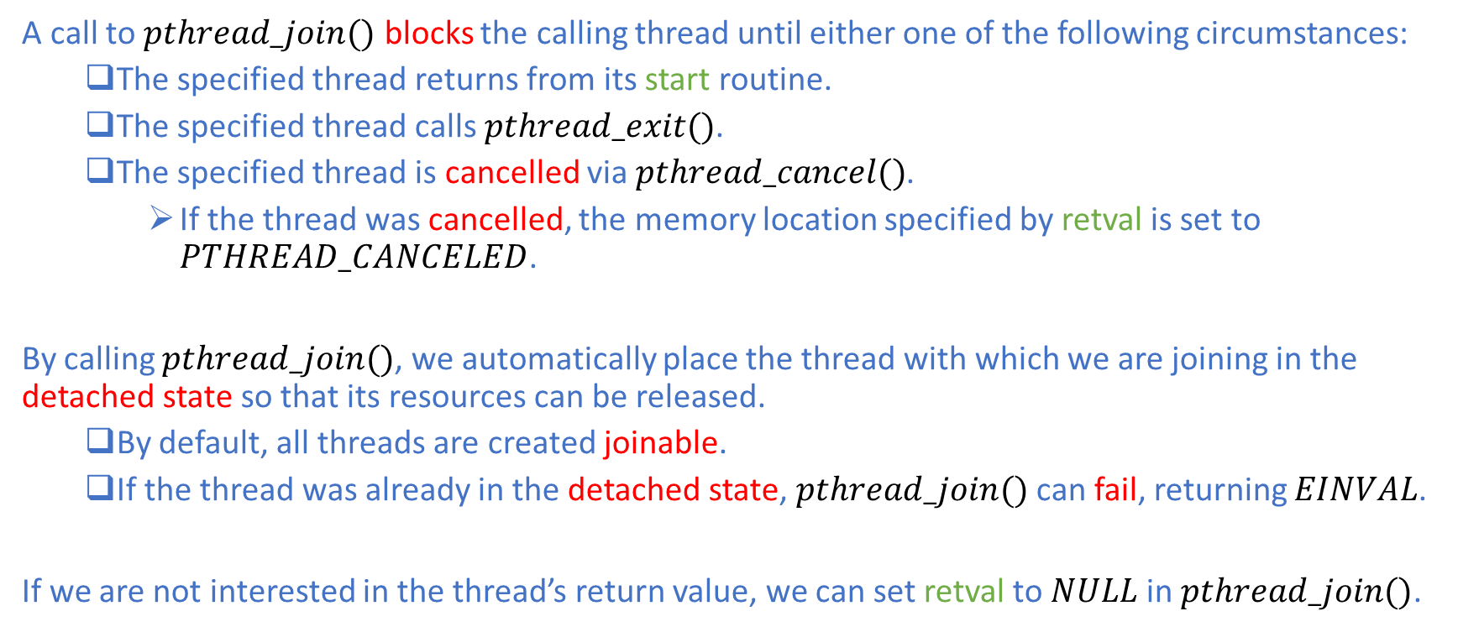
Joining a Thread
A call to $pthread_join()$ blocks the calling thread until either one of the following circumstances:
The specified thread returns from its start routine.
The specified thread calls $pthread_exit()$.
The specified thread is cancelled via $pthread_cancel()$.
If the thread was cancelled, the memory location specified by retval is set to $PTHREAD_CANCELED$.
By calling $pthread_join()$, we automatically place the thread with which we are joining in the detached state so that its resources can be released.
By default, all threads are created joinable.
If the thread was already in the detached state, $pthread_join()$ can fail, returning $EINVAL$.
If we are not interested in the thread’s return value, we can set retval to $NULL$ in $pthread_join()$.

Slide 14
Joining a Thread
Live Demo:
Go to Pthreads/ThreadJoin

Slide 15
Estimate Pi using Monte Carlo
Live Demo:
Go to Pthreads/Pi

Slide 16
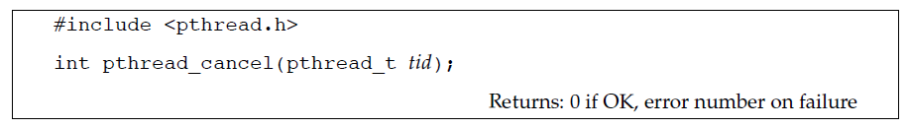
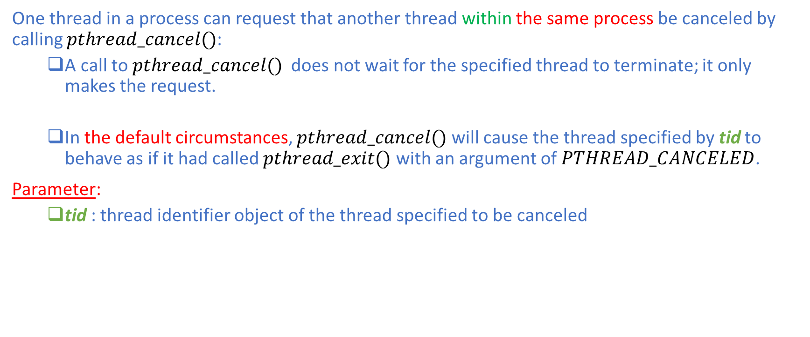
Cancelling a Thread
One thread in a process can request that another thread within the same process be canceled by calling $pthread_cancel()$:
A call to $pthread_cancel()$ does not wait for the specified thread to terminate; it only makes the request.
In the default circumstances, $pthread_cancel()$ will cause the thread specified by tid to behave as if it had called $pthread_exit()$ with an argument of $PTHREAD_CANCELED$.
Parameter:
tid : thread identifier object of the thread specified to be canceled

Slide 17
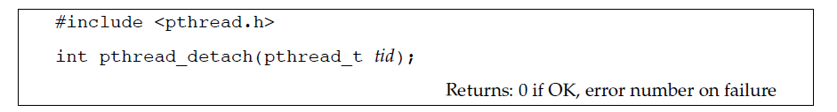
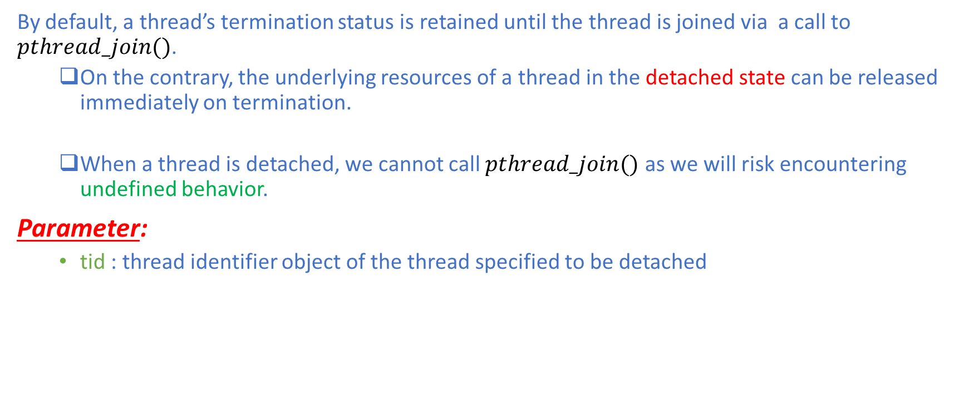
Detaching a Thread
By default, a thread’s termination status is retained until the thread is joined via a call to $pthread_join()$.
On the contrary, the underlying resources of a thread in the detached state can be released immediately on termination.
When a thread is detached, we cannot call $pthread_join()$ as we will risk encountering undefined behavior.
Parameter:
tid : thread identifier object of the thread specified to be detached

Slide 18
Detaching a Thread
Live Demo:
Go to Pthreads/ThreadDetach

Slide 19
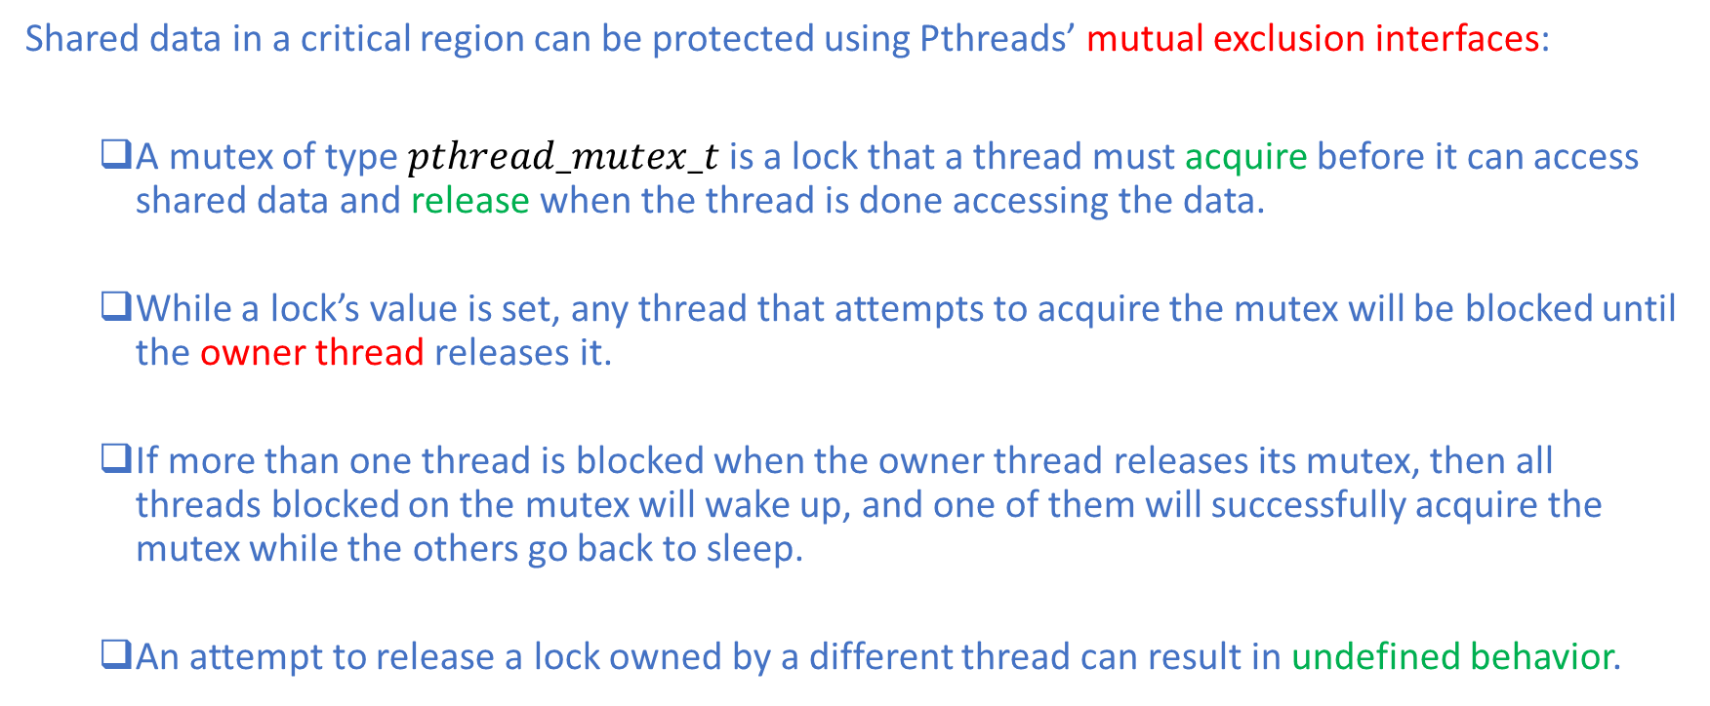
Mutex : Concept
Shared data in a critical region can be protected using Pthreads’ mutual exclusion interfaces:
A mutex of type $pthread_mutex_t$ is a lock that a thread must acquire before it can access shared data and release when the thread is done accessing the data.
While a lock’s value is set, any thread that attempts to acquire the mutex will be blocked until the owner thread releases it.
If more than one thread is blocked when the owner thread releases its mutex, then all threads blocked on the mutex will wake up, and one of them will successfully acquire the mutex while the others go back to sleep.
An attempt to release a lock owned by a different thread can result in undefined behavior.

Slide 20
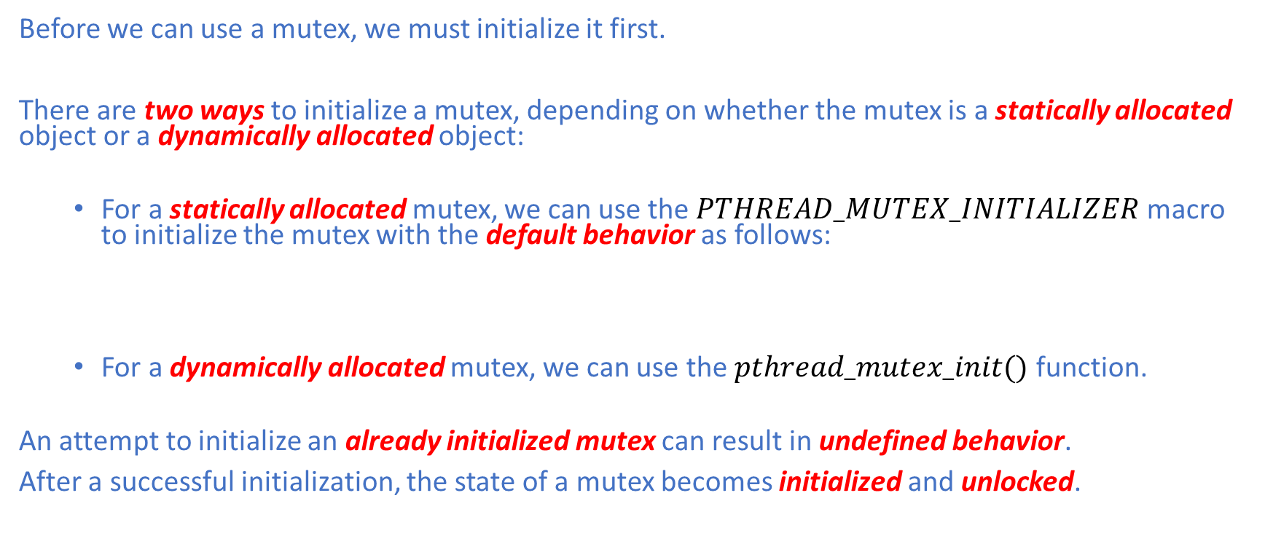
Mutex: Initialization
Before we can use a mutex, we must initialize it first.
There are two ways to initialize a mutex, depending on whether the mutex is a statically allocated object or a dynamically allocated object:
For a statically allocated mutex, we can use the $PTHREAD_MUTEX_INITIALIZER$ macro to initialize the mutex with the default behavior as follows:
For a dynamically allocated mutex, we can use the $pthread_mutex_init()$ function.
An attempt to initialize an already initialized mutex can result in undefined behavior.
After a successful initialization, the state of a mutex becomes initialized and unlocked.

Slide 21
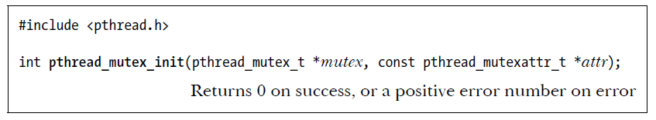
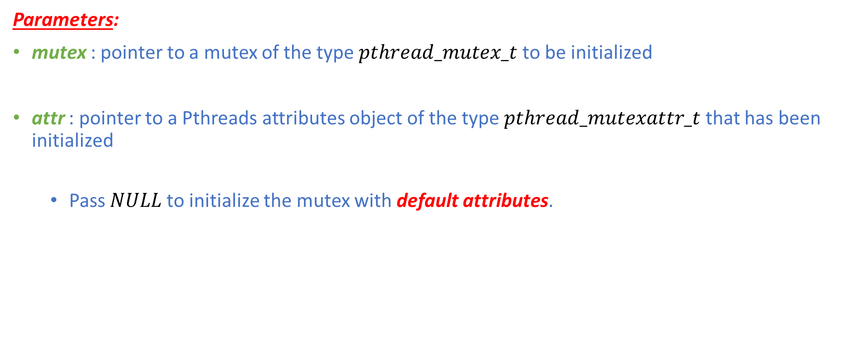
Mutex: Initialization
Parameters:
mutex : pointer to a mutex of the type $pthread_mutex_t$ to be initialized
attr : pointer to a Pthreads attributes object of the type $pthread_mutexattr_t$ that has been initialized
Pass$NULL$ to initialize the mutex with default attributes.

Slide 22
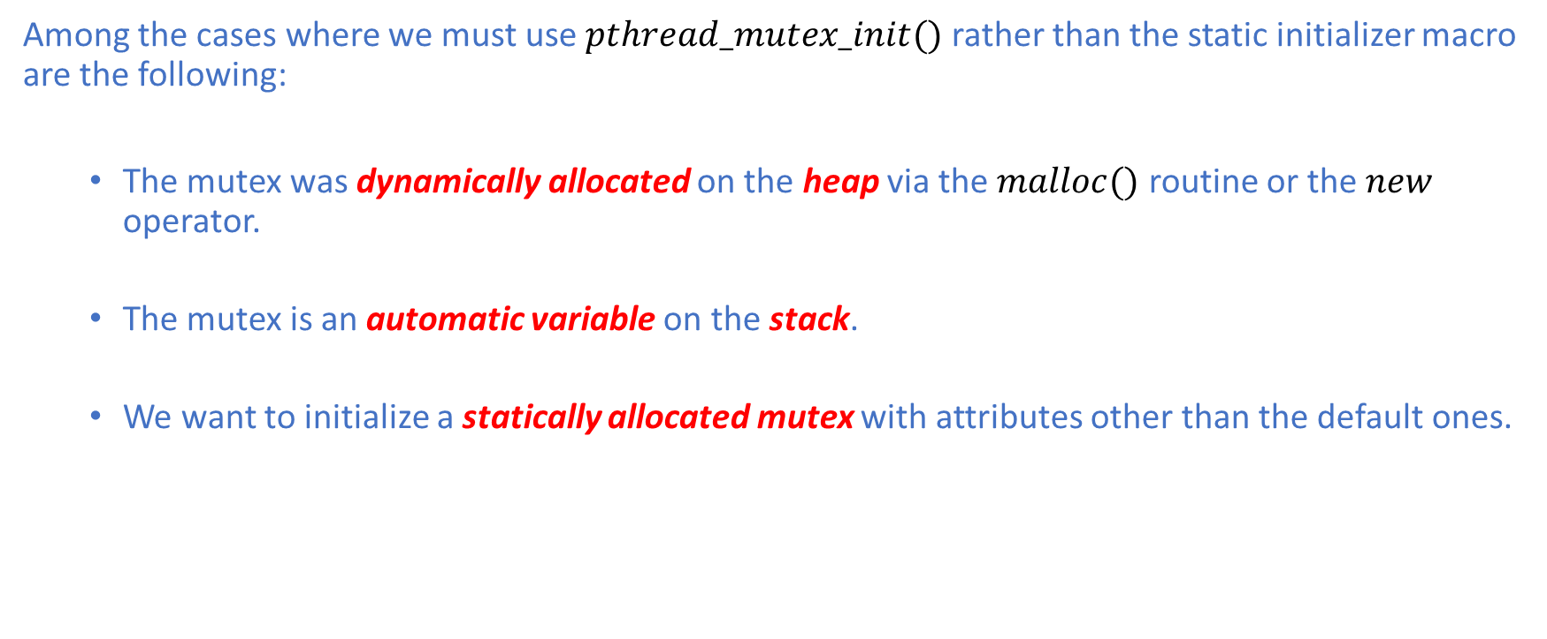
Mutex: Initialization
Among the cases where we must use $pthread_mutex_init()$ rather than the static initializer macro are the following:
The mutex was dynamically allocated on the heap via the $malloc()$ routine or the $new$ operator.
The mutex is an automatic variable on the stack.
We want to initialize a statically allocated mutex with attributes other than the default ones.

Slide 23
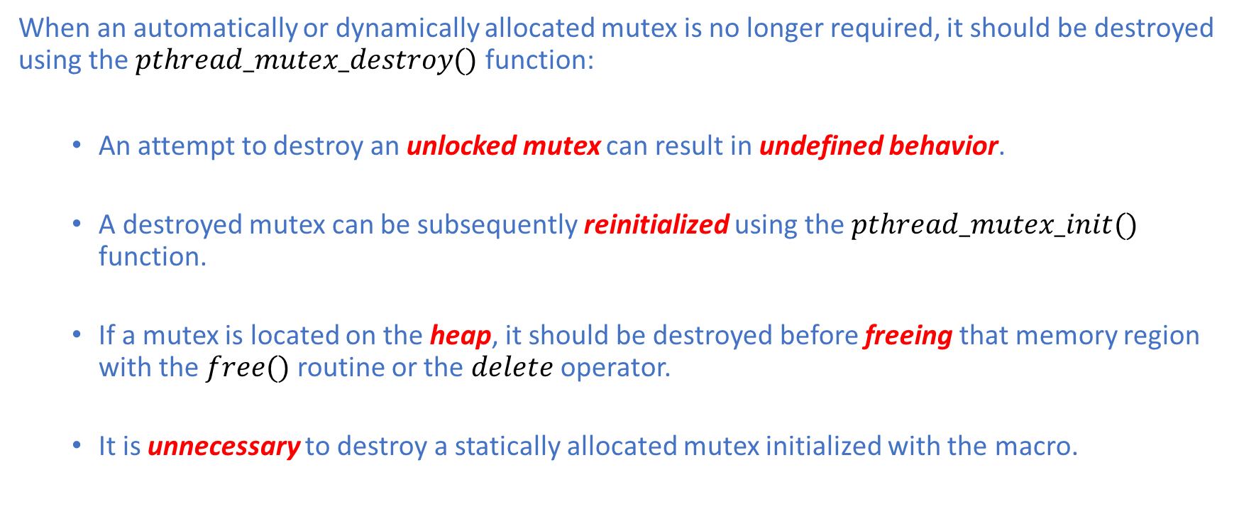
Mutex: Uninitialization
When an automatically or dynamically allocated mutex is no longer required, it should be destroyed using the $pthread_mutex_destroy()$ function:
An attempt to destroy an unlocked mutex can result in undefined behavior.
A destroyed mutex can be subsequently reinitialized using the $pthread_mutex_init()$ function.
If a mutex is located on the heap, it should be destroyed before freeing that memory region with the $free()$ routine or the $delete$ operator.
It is unnecessary to destroy a statically allocated mutex initialized with the macro.

Slide 24
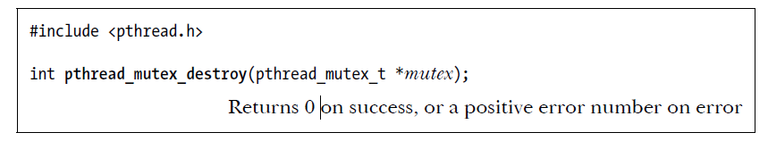

Mutex: Uninitialization
Parameters:
mutex : pointer to a mutex of the type $pthread_mutex_t$ to be destroyed

Slide 25
Mutex: Init & Destroy
Live Demo:
Go to Pthreads/MutexInitDestroy

Slide 26
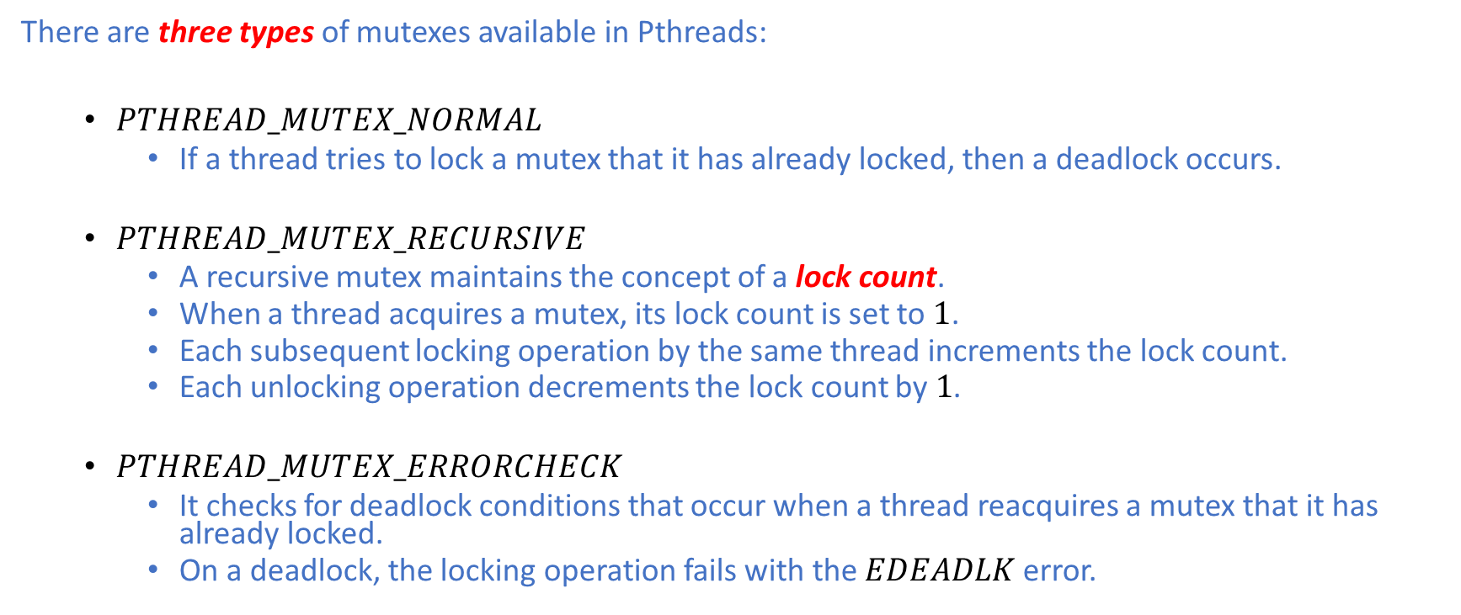
Mutex : Types
There are three types of mutexes available in Pthreads:
$PTHREAD_MUTEX_NORMAL$
If a thread tries to lock a mutex that it has already locked, then a deadlock occurs.
$PTHREAD_MUTEX_RECURSIVE$
A recursive mutex maintains the concept of a lock count.
When a thread acquires a mutex, its lock count is set to $1$.
Each subsequent locking operation by the same thread increments the lock count.
Each unlocking operation decrements the lock count by$1$.
$PTHREAD_MUTEX_ERRORCHECK$
It checks for deadlock conditions that occur when a thread reacquires a mutex that it has already locked.
On a deadlock, the locking operation fails with the $EDEADLK$ error.

Slide 27
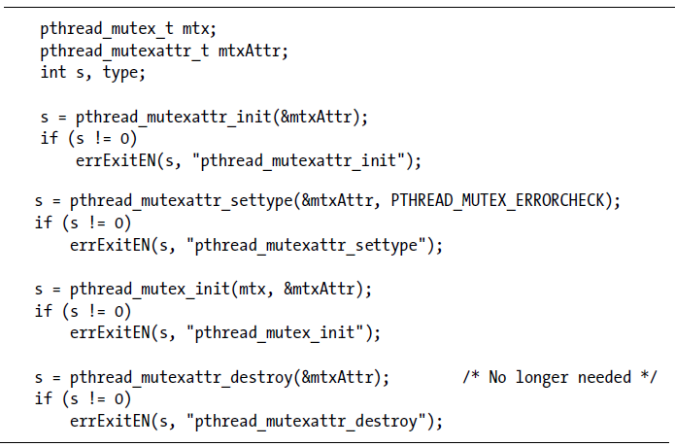
Mutex : Types

Slide 28
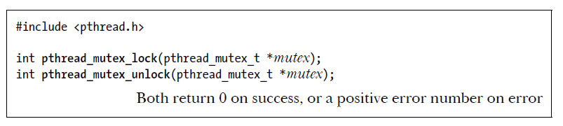

Mutex: Locking & Unlocking
After initialization, a mutex is unlocked.
To lock and unlock a mutex, we use the $pthread_mutex_lock()$ and $pthread_mutex_unlock()$ functions, respectively.
Parameters:
mutex : pointer to the mutex to be locked or unlocked

Slide 29
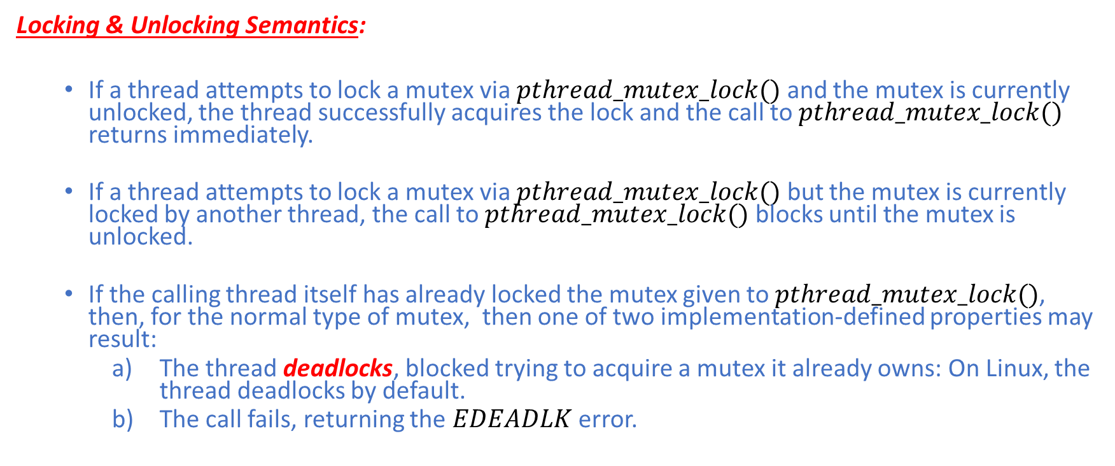
Mutex: Locking & Unlocking
Locking & Unlocking Semantics:
If a thread attempts to lock a mutex via $pthread_mutex_lock()$ and the mutex is currently unlocked, the thread successfully acquires the lock and the call to $pthread_mutex_lock()$ returns immediately.
If a thread attempts to lock a mutex via $pthread_mutex_lock()$ but the mutex is currently locked by another thread, the call to $pthread_mutex_lock()$ blocks until the mutex is unlocked.
If the calling thread itself has already locked the mutex given to $pthread_mutex_lock()$, then, for the normal type of mutex, then one of two implementation-defined properties may result:
The thread deadlocks, blocked trying to acquire a mutex it already owns: On Linux, the thread deadlocks by default.
The call fails, returning the $EDEADLK$ error.

Slide 30
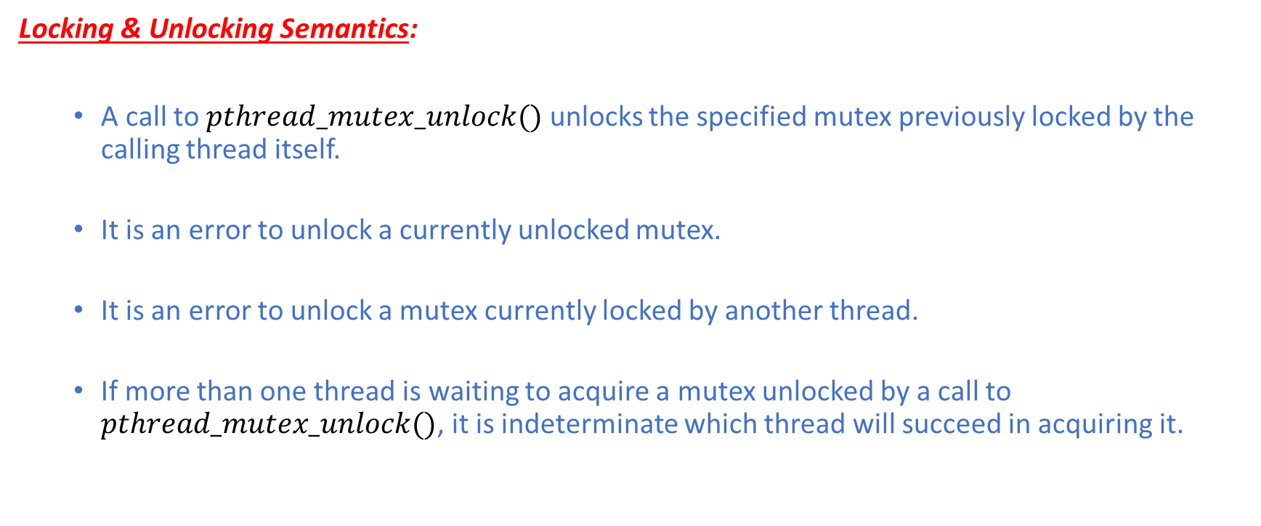
Mutex: Locking & Unlocking
Locking & Unlocking Semantics:
A call to $pthread_mutex_unlock()$ unlocks the specified mutex previously locked by the calling thread itself.
It is an error to unlock a currently unlocked mutex.
It is an error to unlock a mutex currently locked by another thread.
If more than one thread is waiting to acquire a mutex unlocked by a call to $pthread_mutex_unlock()$, it is indeterminate which thread will succeed in acquiring it.

Slide 31
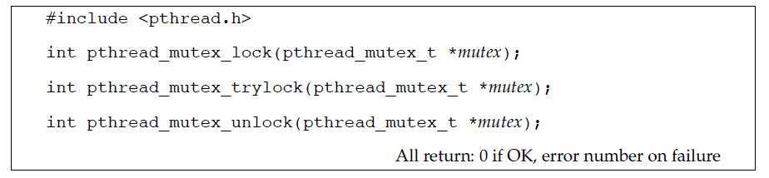

Mutex: Locking Variants
The Pthreads API provides two other variants of the $pthread_mutex_lock()$ function.
The $pthread_mutex_trylock()$ function is the same as the $pthread_mutex_lock()$ function, except that if the mutex is currently locked, a call to $pthread_mutex_trylock()$ fails and immediately returns the $EBUSY$ error.

Slide 32
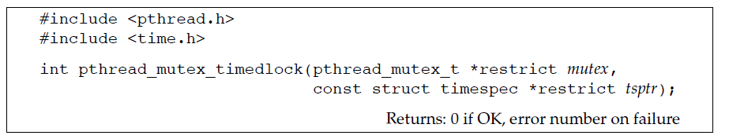
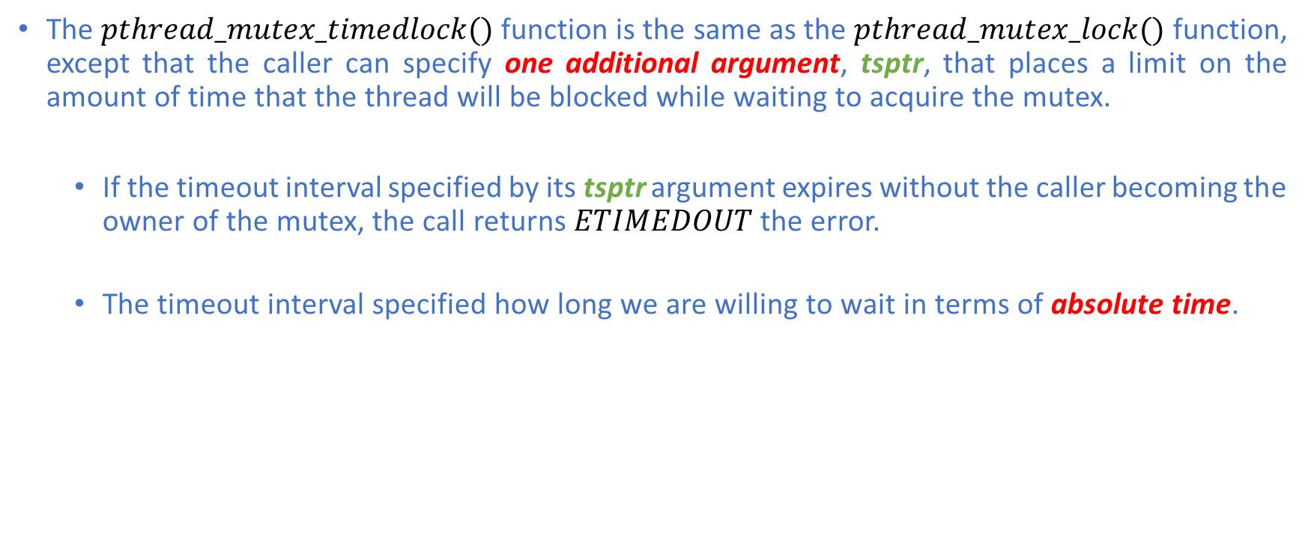
Mutex: Locking Variants
The $pthread_mutex_timedlock()$ function is the same as the $pthread_mutex_lock()$ function, except that the caller can specify one additional argument, tsptr, that places a limit on the amount of time that the thread will be blocked while waiting to acquire the mutex.
If the timeout interval specified by its tsptr argument expires without the caller becoming the owner of the mutex, the call returns $ETIMEDOUT$the error.
The timeout interval specified how long we are willing to wait in terms of absolute time.

Slide 33
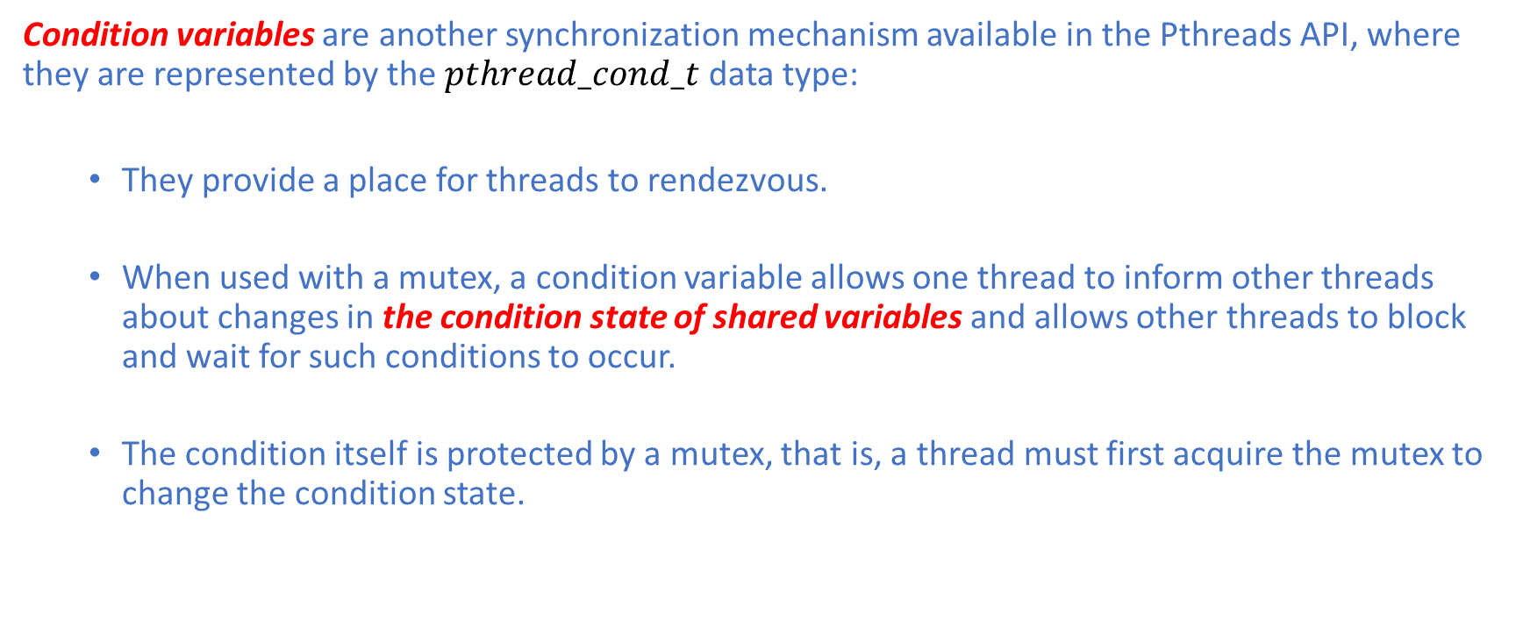
Condition Variable
Condition variables are another synchronization mechanism available in the Pthreads API, where they are represented by the $pthread_cond_t$ data type:
They provide a place for threads to rendezvous.
When used with a mutex, a condition variable allows one thread to inform other threads about changes in the condition state of shared variables and allows other threads to block and wait for such conditions to occur.
The condition itself is protected by a mutex, that is, a thread must first acquire the mutex to change the condition state.

Slide 34

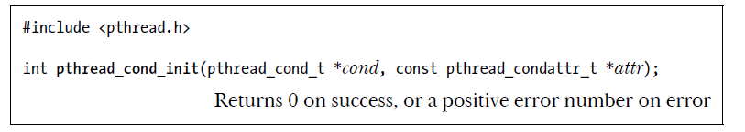
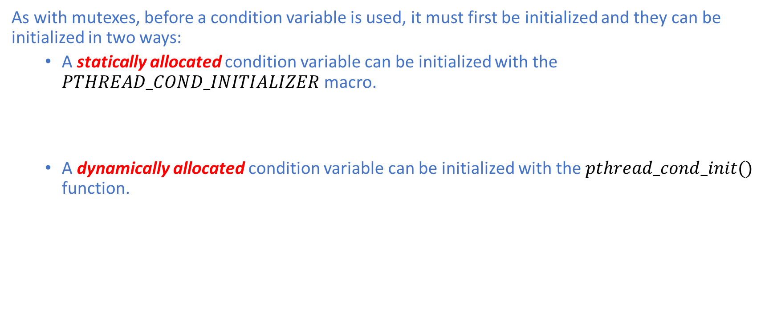
Condition Variable: Initialization
As with mutexes, before a condition variable is used, it must first be initialized and they can be initialized in two ways:
A statically allocated condition variable can be initialized with the $PTHREAD_COND_INITIALIZER$ macro.
A dynamically allocated condition variable can be initialized with the $pthread_cond_init()$ function.

Slide 35
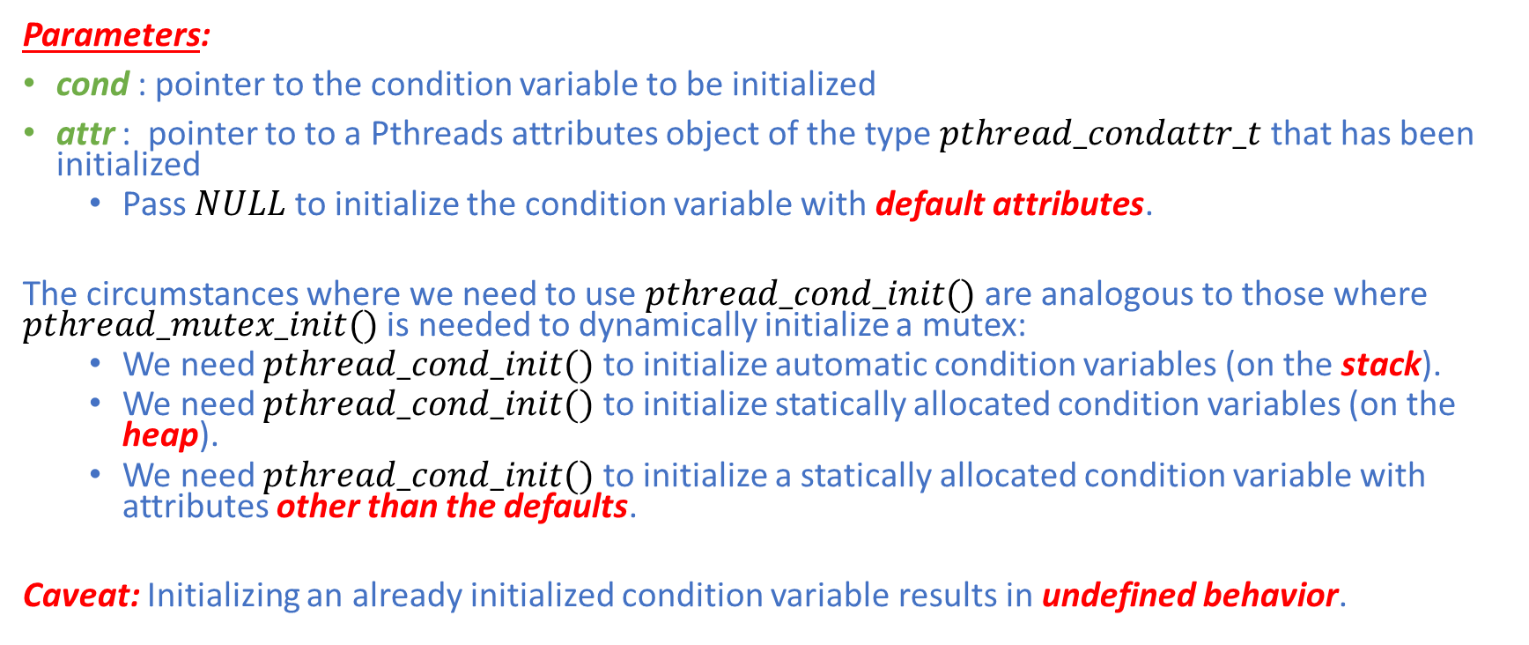
Condition Variable: Initialization
Parameters:
cond : pointer to the condition variable to be initialized
attr : pointer to to a Pthreads attributes object of the type $pthread_condattr_t$ that has been initialized
Pass$NULL$ to initialize the condition variable with default attributes.
The circumstances where we need to use $pthread_cond_init()$ are analogous to those where $pthread_mutex_init()$ is needed to dynamically initialize a mutex:
We need $pthread_cond_init()$ to initialize automatic condition variables (on the stack).
We need $pthread_cond_init()$ to initialize statically allocated condition variables (on the heap).
We need $pthread_cond_init()$ to initialize a statically allocated condition variable with attributes other than the defaults.
Caveat: Initializing an already initialized condition variable results in undefined behavior.

Slide 36
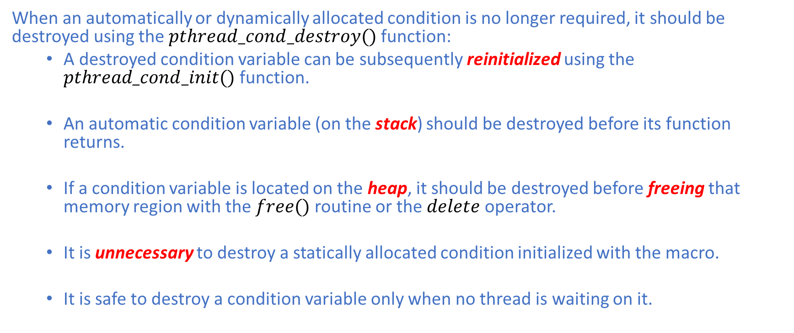
Condition Variable: Uninitialization
When an automatically or dynamically allocated condition is no longer required, it should be destroyed using the $pthread_cond_destroy()$ function:
A destroyed condition variable can be subsequently reinitialized using the $pthread_cond_init()$ function.
An automatic condition variable (on the stack) should be destroyed before its function returns.
If a condition variable is located on the heap, it should be destroyed before freeing that memory region with the $free()$ routine or the $delete$ operator.
It is unnecessary to destroy a statically allocated condition initialized with the macro.
It is safe to destroy a condition variable only when no thread is waiting on it.

Slide 37
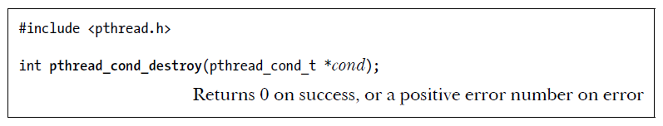

Condition Variable: Uninitialization
Parameters:
cond : pointer to a condition variable of the type $pthread_cond_t$ to be destroyed

Slide 38
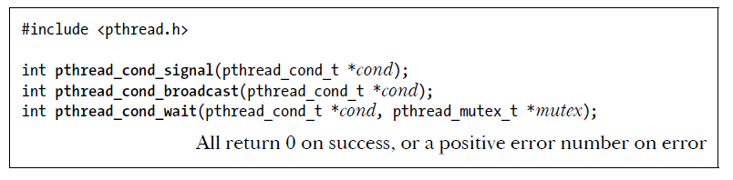
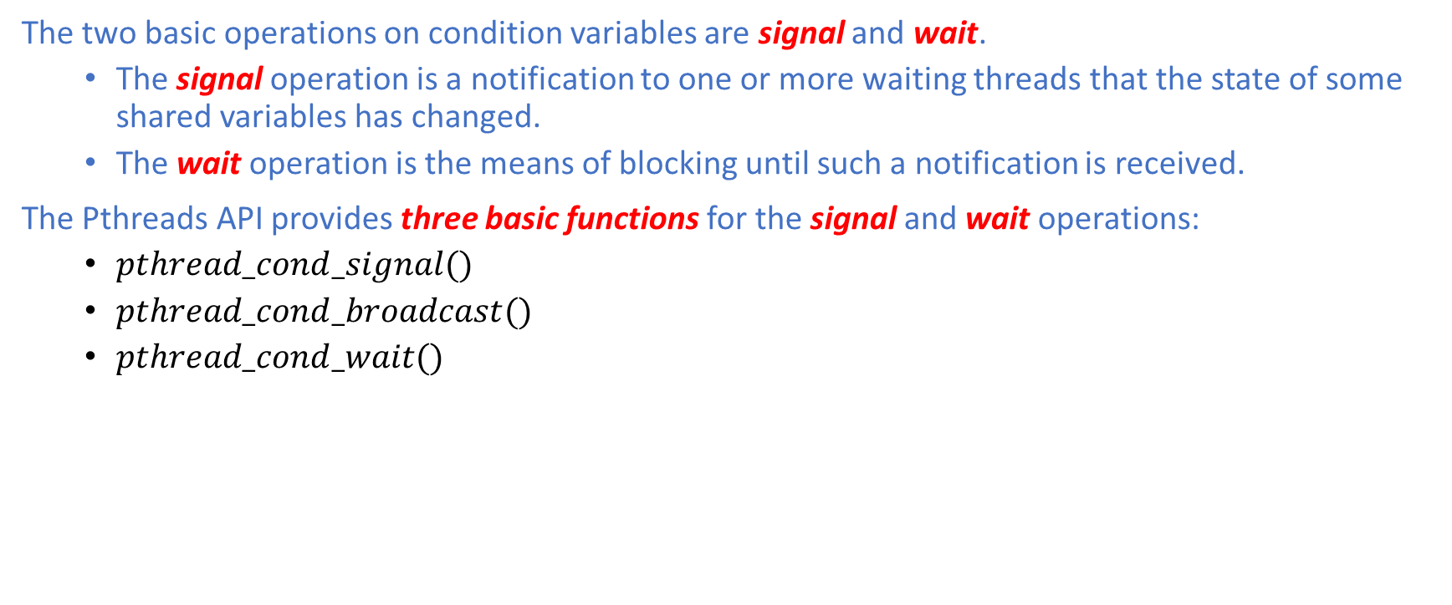
Condition Variable: Signaling & Waiting
The two basic operations on condition variables are signal and wait.
The signal operation is a notification to one or more waiting threads that the state of some shared variables has changed.
The wait operation is the means of blocking until such a notification is received.
The Pthreads API provides three basic functions for the signal and wait operations:
$pthread_cond_signal()$
$pthread_cond_broadcast()$
$pthread_cond_wait()$

Slide 39
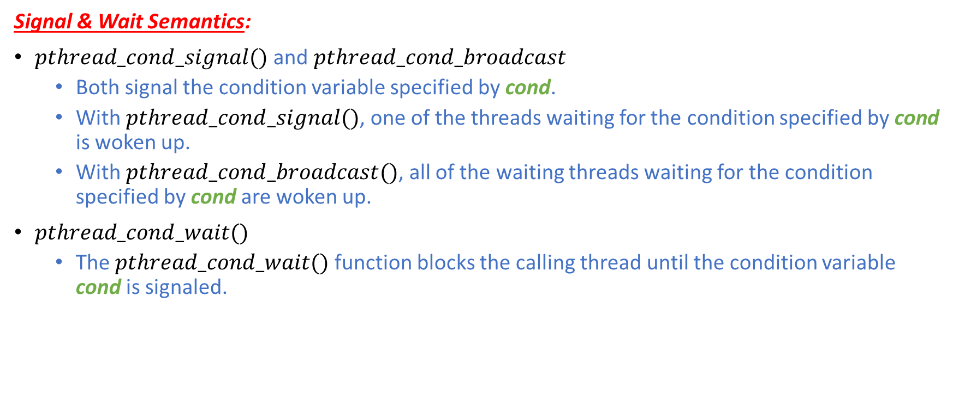
Condition Variable: Signaling & Waiting
Signal & Wait Semantics:
$pthread_cond_signal()$ and $pthread_cond_broadcast$
Both signal the condition variable specified by cond.
With $pthread_cond_signal()$, one of the threads waiting for the condition specified by cond is woken up.
With $pthread_cond_broadcast()$, all of the waiting threads waiting for the condition specified by cond are woken up.
$pthread_cond_wait()$
The $pthread_cond_wait()$ function blocks the calling thread until the condition variable cond is signaled.

Slide 40
Condition Variable: Signaling & Waiting
A condition variable holds no state information.
If no thread is waiting on the condition variable at the time that it is signaled, then the signal is lost.
A thread that later waits on the condition variable will unblock only when the variable is signaled once more.
The use of a condition variable must always be associated with a mutex.
The thread locks the mutex in preparation for checking the state of the shared variable.
The state of the shared variable is checked.
If the shared variable is not in the desired state, then the thread must unlock the mutex before it goes to sleep on the condition variable.
When the thread is woken up again because the condition variable has been signaled, the thread must once more be locked since, typically, the thread then immediately accesses the shared variable.

Slide 41
Condition Variable: Signaling & Waiting
Live Demo:
Go to Pthreads/BBProblem

Slide 42
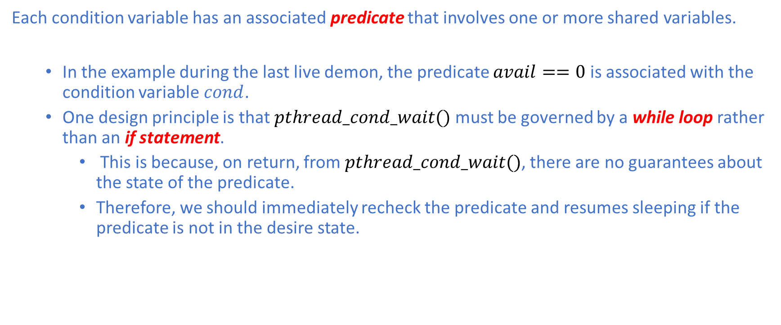
Condition Variable: Signaling & Waiting
Each condition variable has an associated predicate that involves one or more shared variables.
In the example during the last live demon, the predicate $avail==0$ is associated with the condition variable $cond$.
One design principle is that $pthread_cond_wait()$ must be governed by a while loop rather than an if statement.
This is because, on return, from $pthread_cond_wait()$, there are no guarantees about the state of the predicate.
Therefore, we should immediately recheck the predicate and resumes sleeping if the predicate is not in the desire state.

Slide 43
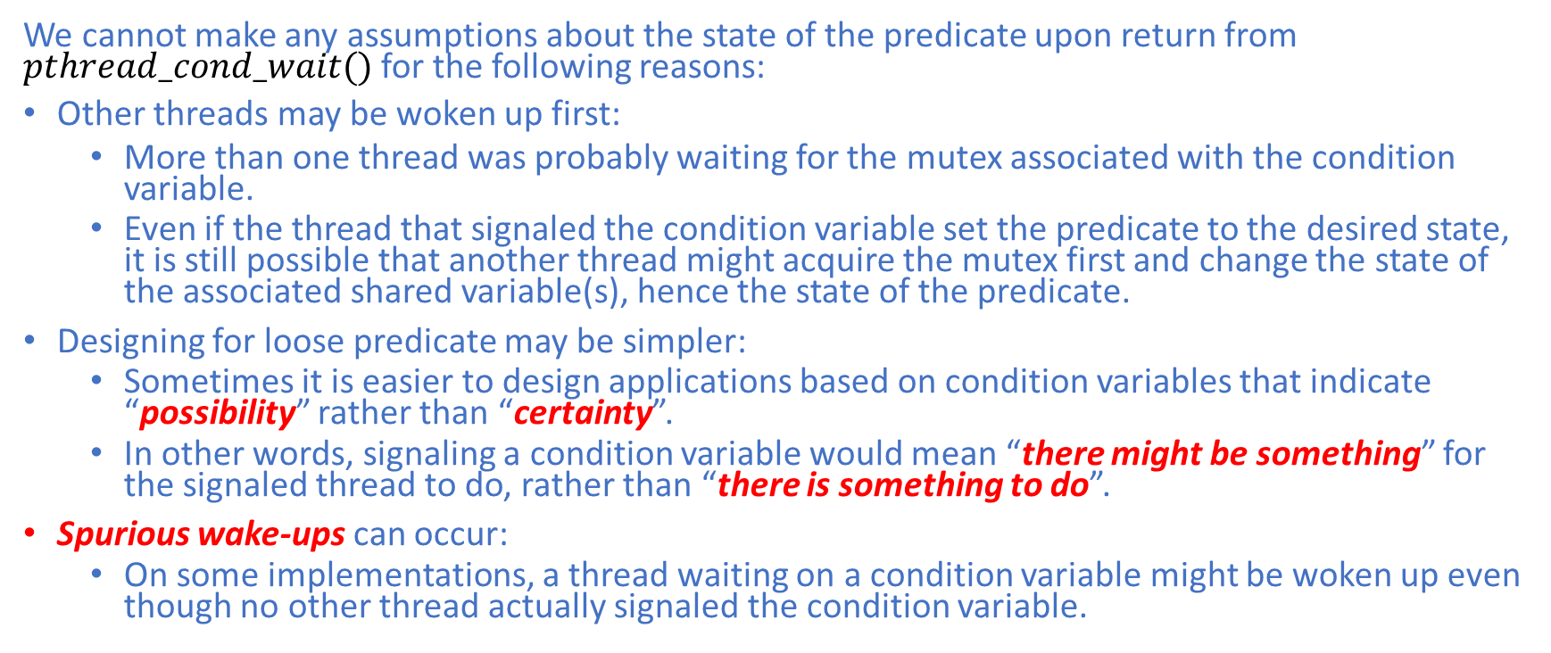
Condition Variable: Signaling & Waiting
We cannot make any assumptions about the state of the predicate upon return from $pthread_cond_wait()$ for the following reasons:
Other threads may be woken up first:
More than one thread was probably waiting for the mutex associated with the condition variable.
Even if the thread that signaled the condition variable set the predicate to the desired state, it is still possible that another thread might acquire the mutex first and change the state of the associated shared variable(s), hence the state of the predicate.
Designing for loose predicate may be simpler:
Sometimes it is easier to design applications based on condition variables that indicate “possibility” rather than “certainty”.
In other words, signaling a condition variable would mean “there might be something” for the signaled thread to do, rather than “there is something to do”.
Spurious wake-ups can occur:
On some implementations, a thread waiting on a condition variable might be woken up even though no other thread actually signaled the condition variable.

Slide 44
References
[1] Bradford Nichols, Dick Buttlar, and Jacqueline Proulx Farrell. 1996. Pthreads programming. O'Reilly & Associates, Inc., USA.
[2] Michael Kerrisk. 2010. The Linux Programming Interface: A Linux and UNIX System Programming Handbook (1st. ed.). No Starch Press, USA.
[3] Vipin Kumar, Ananth Grama, Anshul Gupta, and George Karypis. 1994. Introduction to parallel computing: design and analysis of algorithms. Benjamin-Cummings Publishing Co., Inc., USA.

